Slide 1
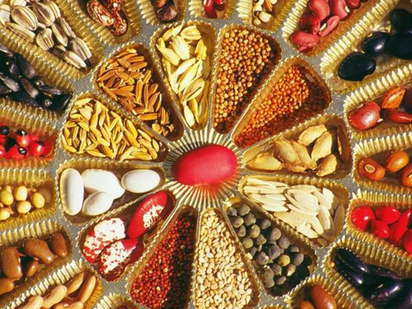

Slide 2
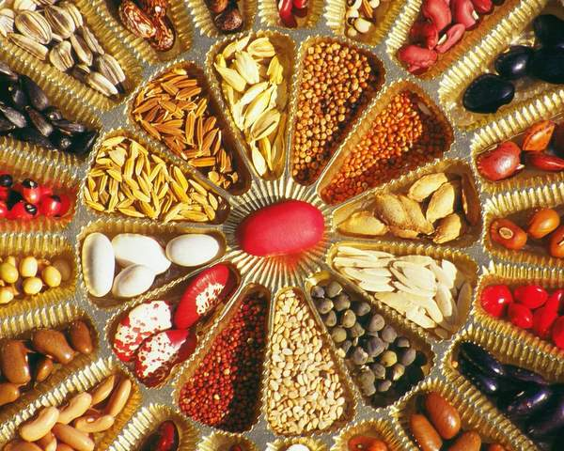
Sahaja Samrudha , an organic farmers’ collective began in 2001 as a farmer initiative to exchange ideas, seeds and knowledge on sustainable agriculture.
It has networked with 250 NGOs, Farmer groups, Research institutions, Media, consumer councils and schools to instilling biodiversity based ecological agriculture systems across India.
Sahaja Samrudha working with more than 7000 farmer breeders and seed savers across India has strived to conserve a repository of more than 800 varieties of rice, 120 millets, 23 Indian cotton, 32 wheat, 56 eggplant, 52 pulses, 182 vegetables and many traditional fruit varieties.
32 community seed banks that have been established to strengthen local seed supply systems.

Slide 3
Sahaja Samrudha Organic producers company Ltd has been formed to market a wide range of traditional crops and value added products. The company has grown year after year with a breakeven in the year 2013. In 2014-15 the annual turnover was Rs.3.6 crores, 2015-16 - Rs. 5.57 crores and in 2018-19 about 8.0 crores.
‘DESI SEED PRODUCER COMPANY LTD’, India's first organic farmers seed company was established in 2014,to link organic seed producers to the market and promote farmer based seed supply systems while popularising the traditional seeds.
2018-19 the annual turnover was 40 lakhs

Slide 4
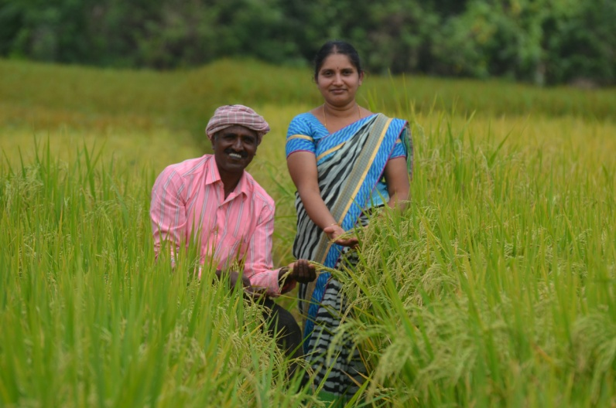
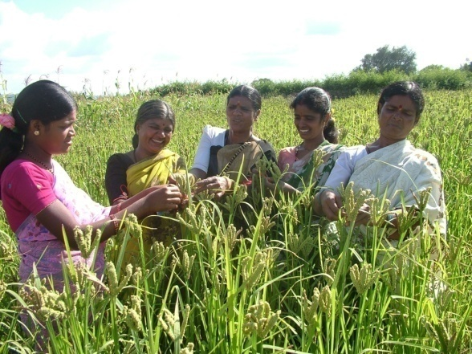
Innovations in Natural Farming - Indigenous Seeds for climate change mitigation and resilience
Problem Statement
Results
Loss of Diversity
Dependency on Markets for Seeds
Poor Quality Seeds
Not Suitable for local climate and food systems
Crop Loss
States | On farm Conservation | Seed Producers
Karnataka | 7000 | 58
West Bengal | 450 | 5
7000
Seed savers
60,00,000
Seeds sale
32
Community Seed Banks
60
Revived lost crops
Can withstand extreme weather! (Climate resilience)
Ragi
All cropping seasons, throughout India
The Innovation
Cultivating Diversity
Partcipatory Crop Improvement
Climate resilient crops
Doubled Income to approximately 25000 INR/ acre/ season
Linked traditional crop producers to the markets. Sold Rs.9 crores worth of organic produce
Extremely nutritious

Slide 5
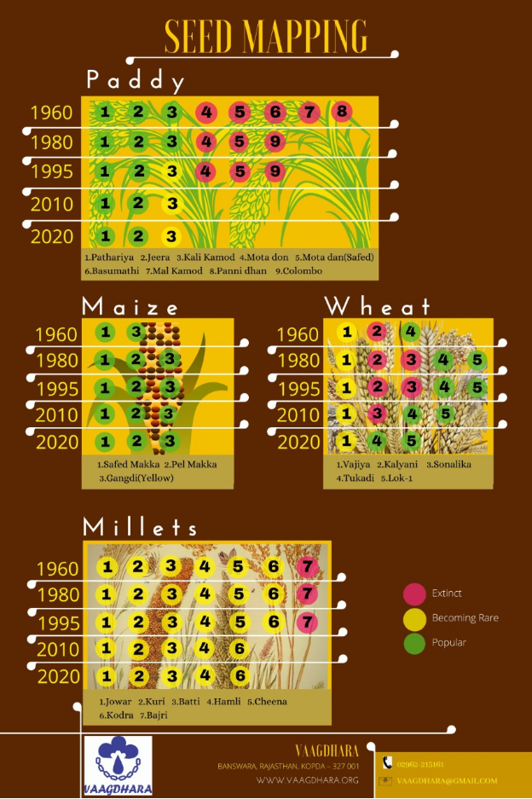
The seed map shows the millet diversity was rich during the 60’s and there has been a considerable decrease in the recent past. The erosion of millet diversity is due to the arrival of high yielding wheat varieties and the mono cropping system followed by the farmers.

Slide 6
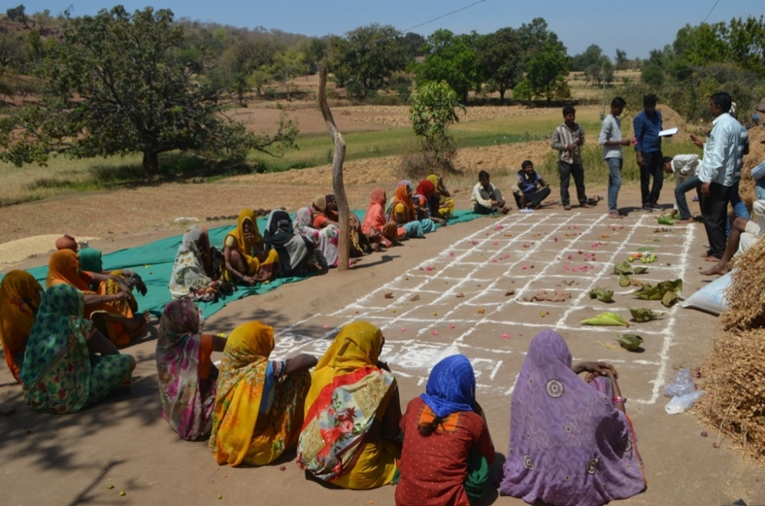
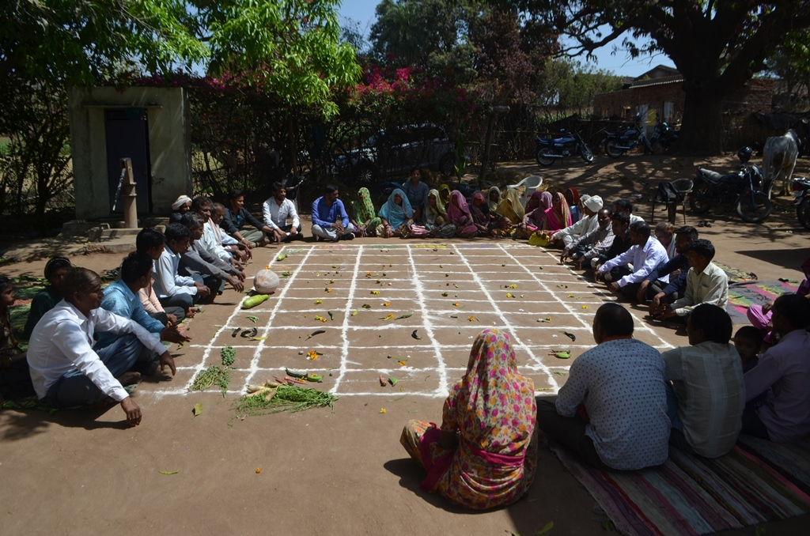
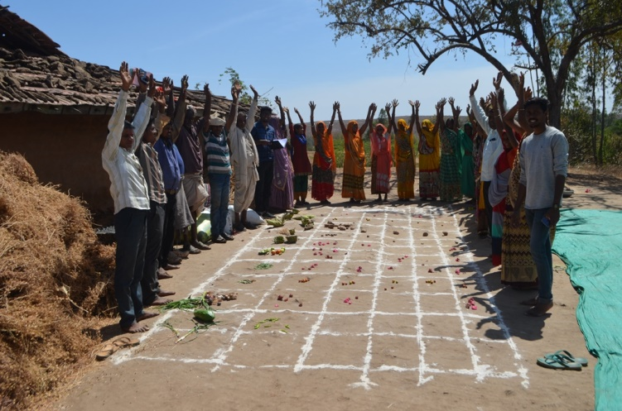
Seed mapping

Slide 7
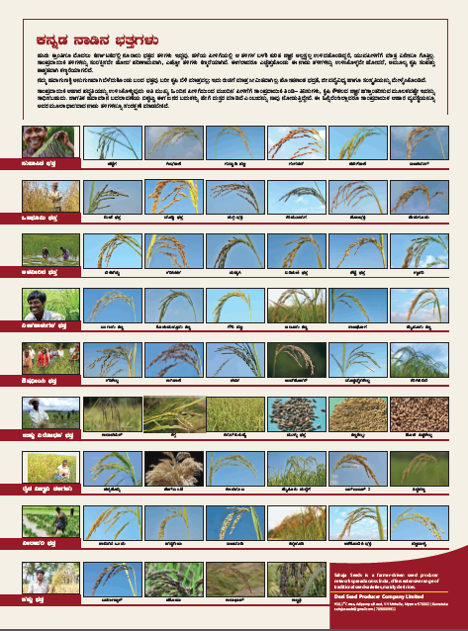

Slide 8
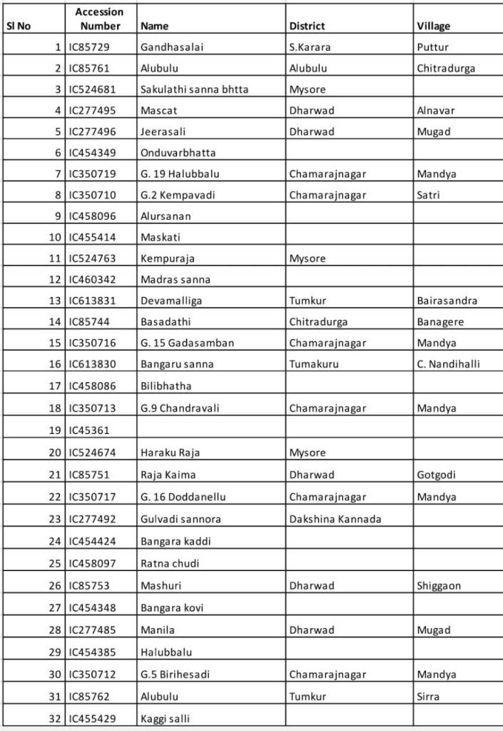
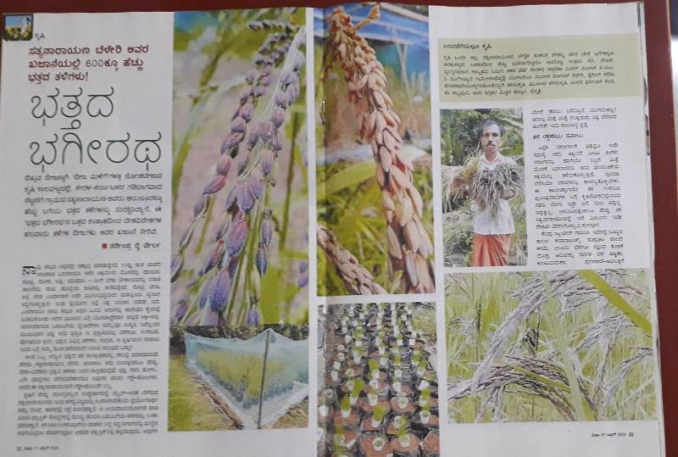
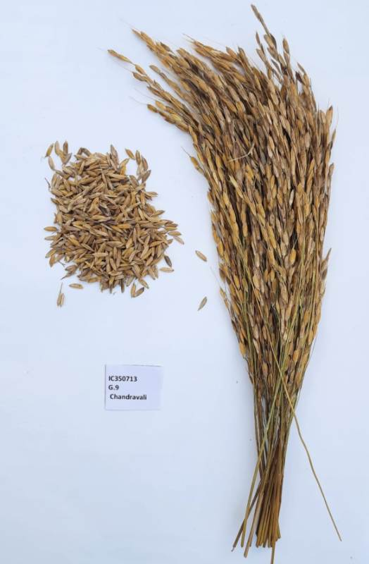
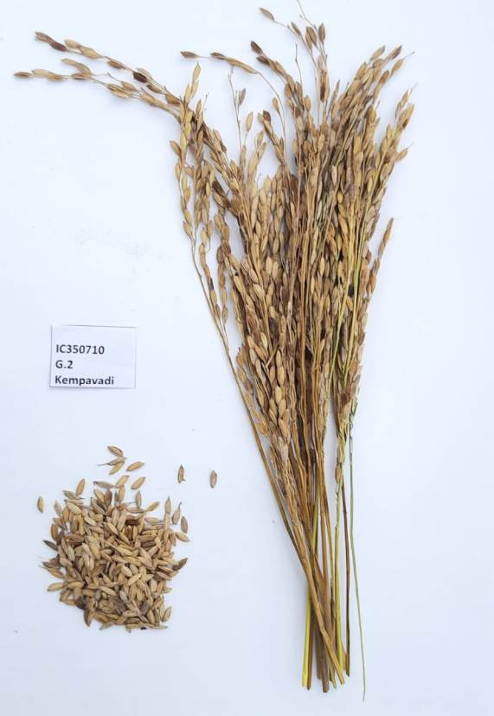
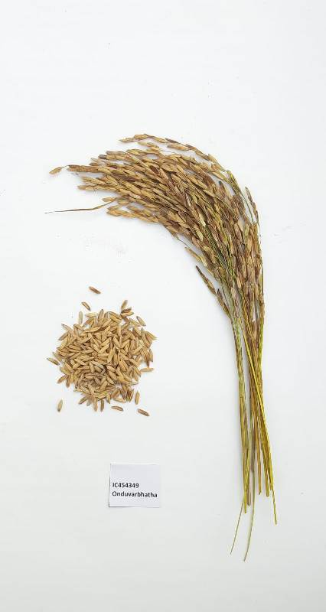

Slide 9
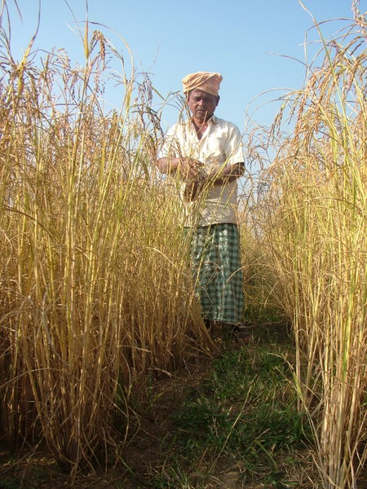
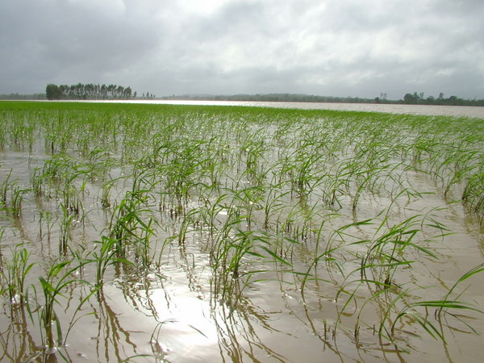
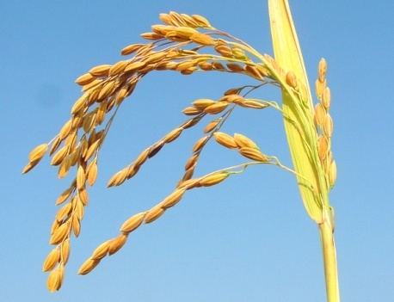
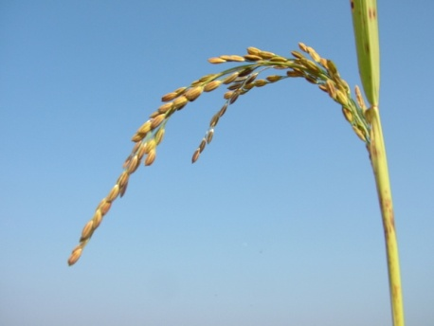
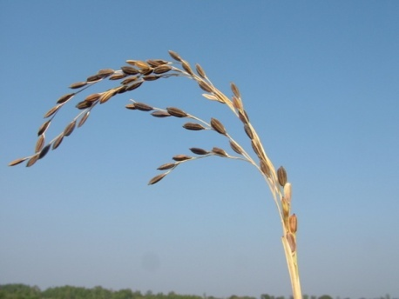
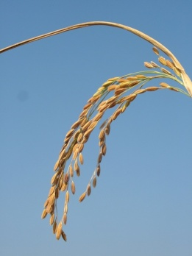
Flood tolerant rice varities

Slide 10
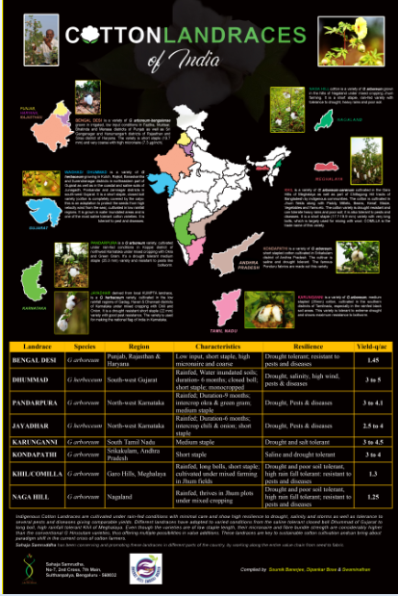
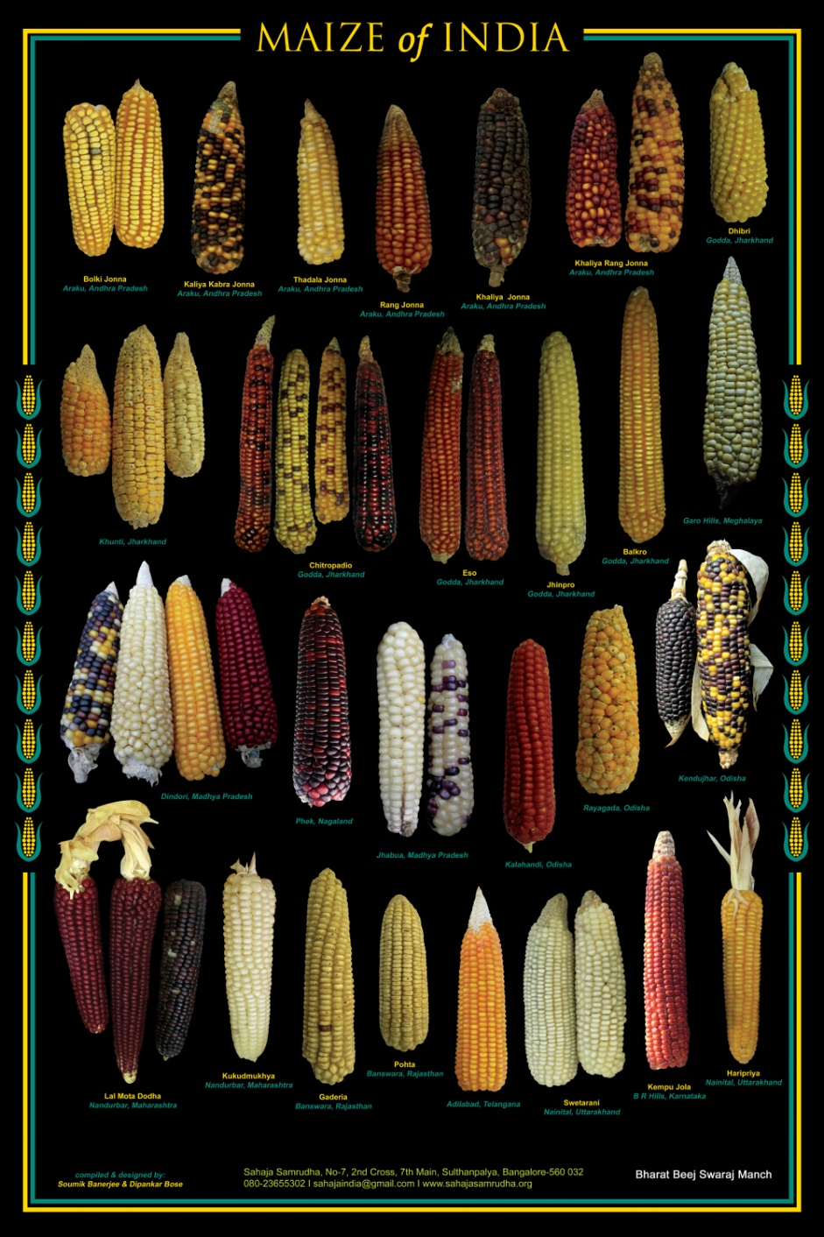

Slide 11
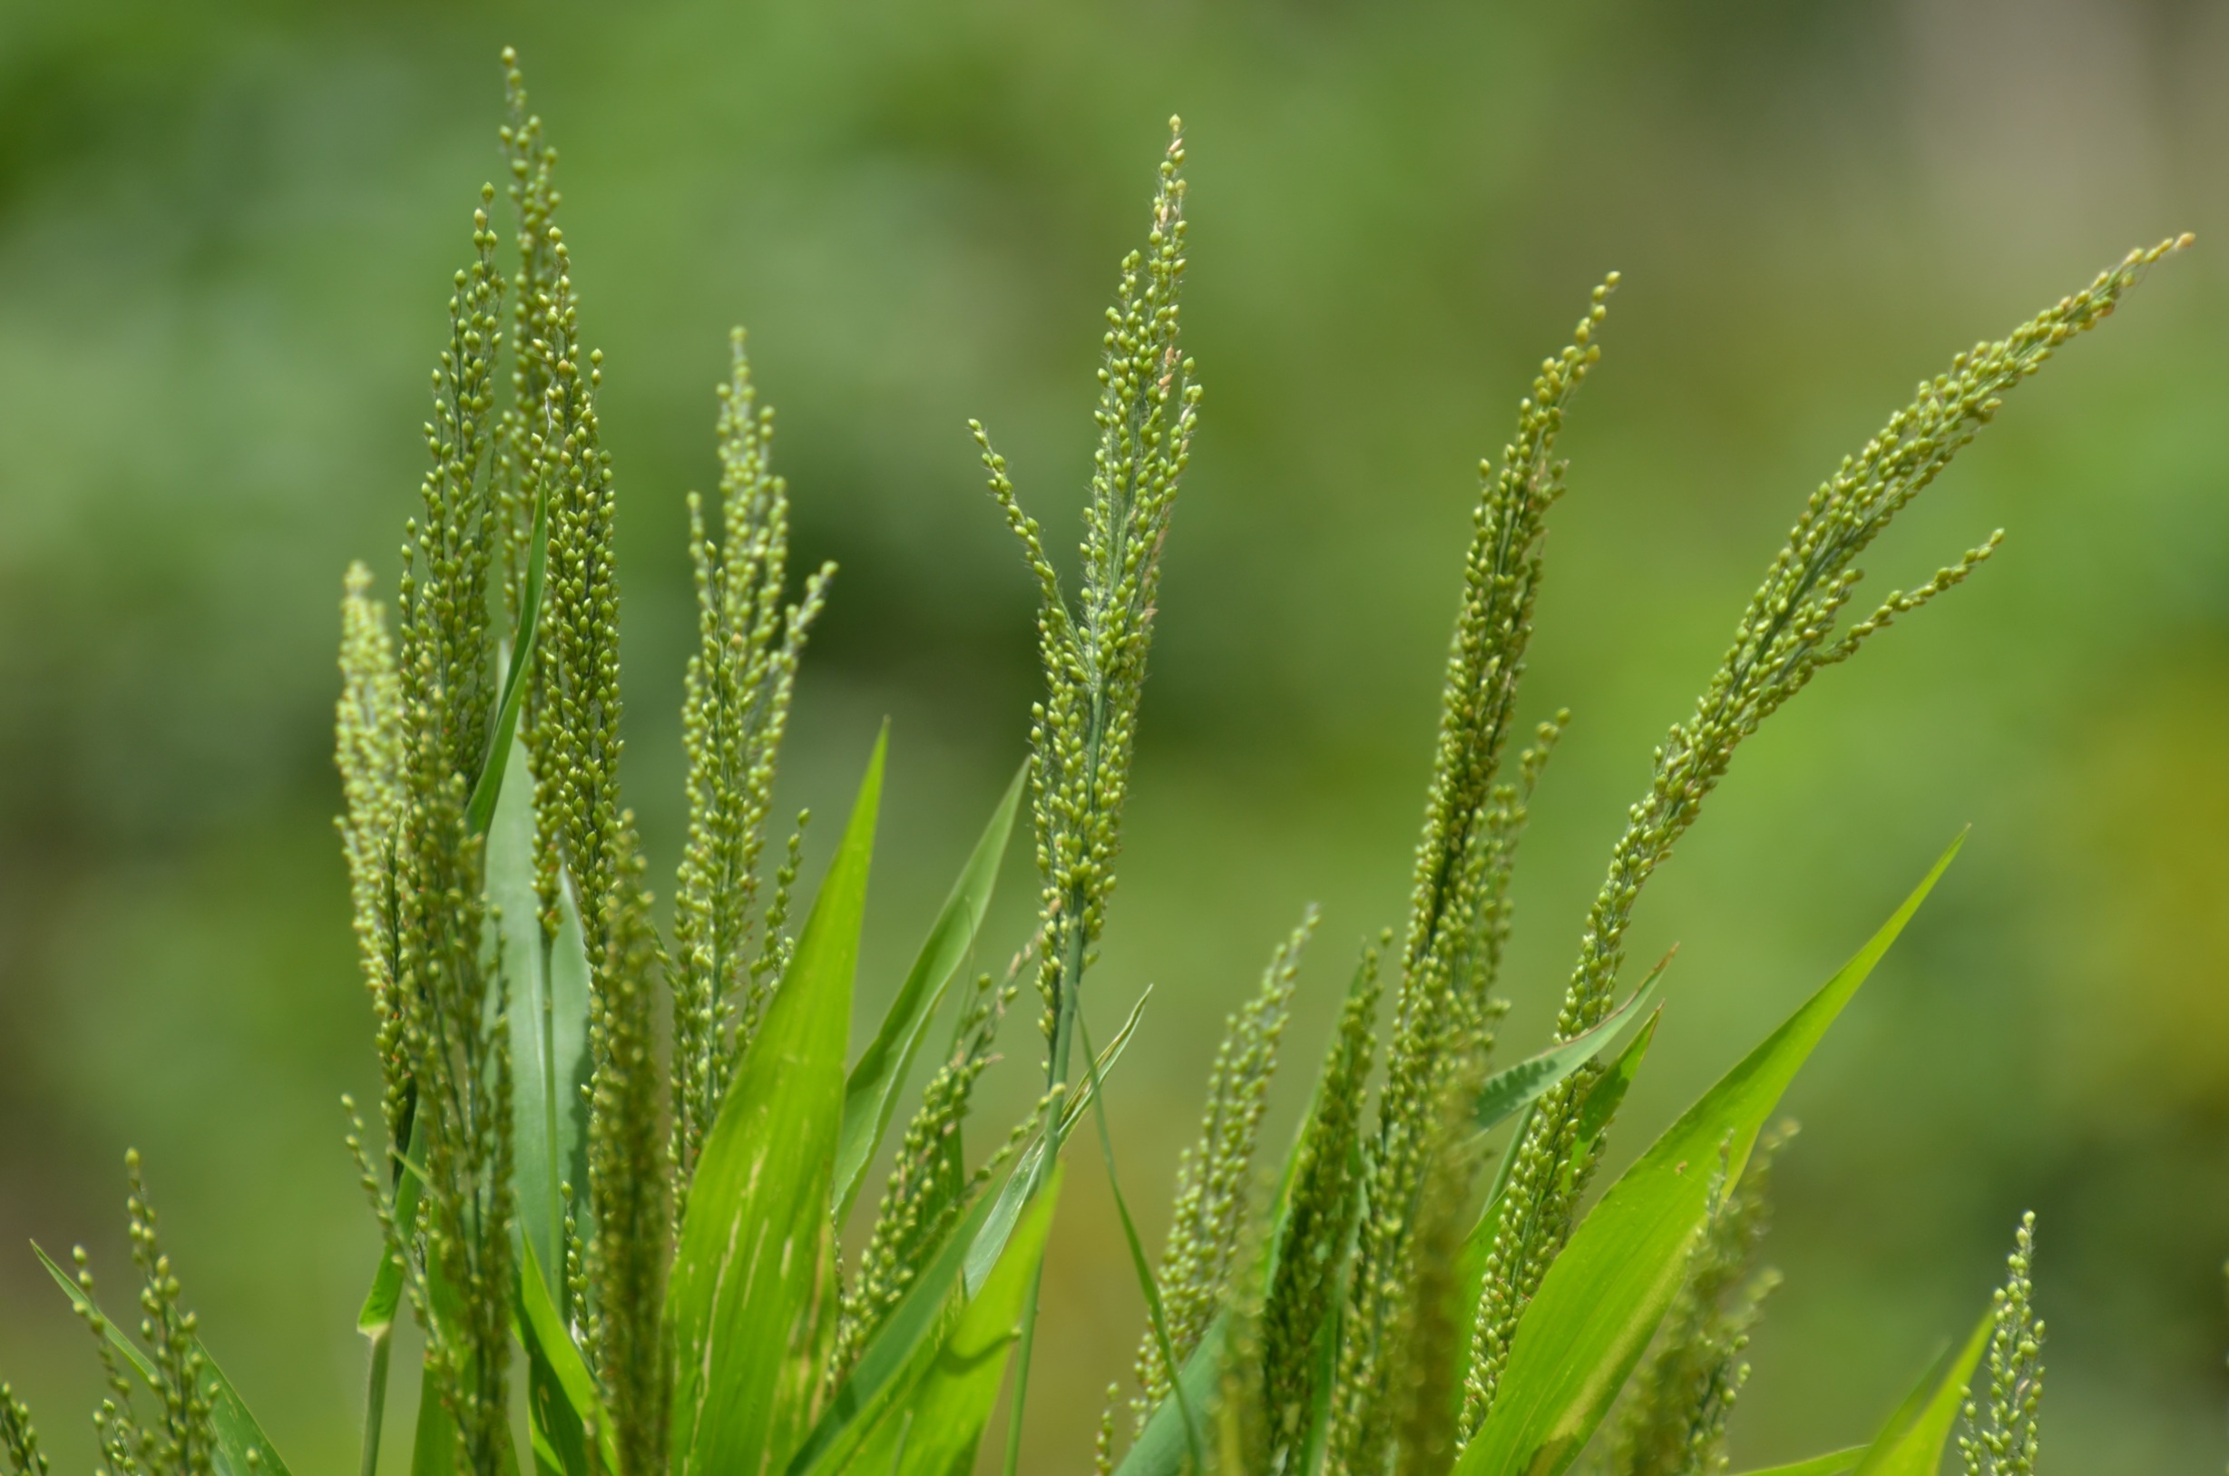
Revival of lost crops

Slide 12
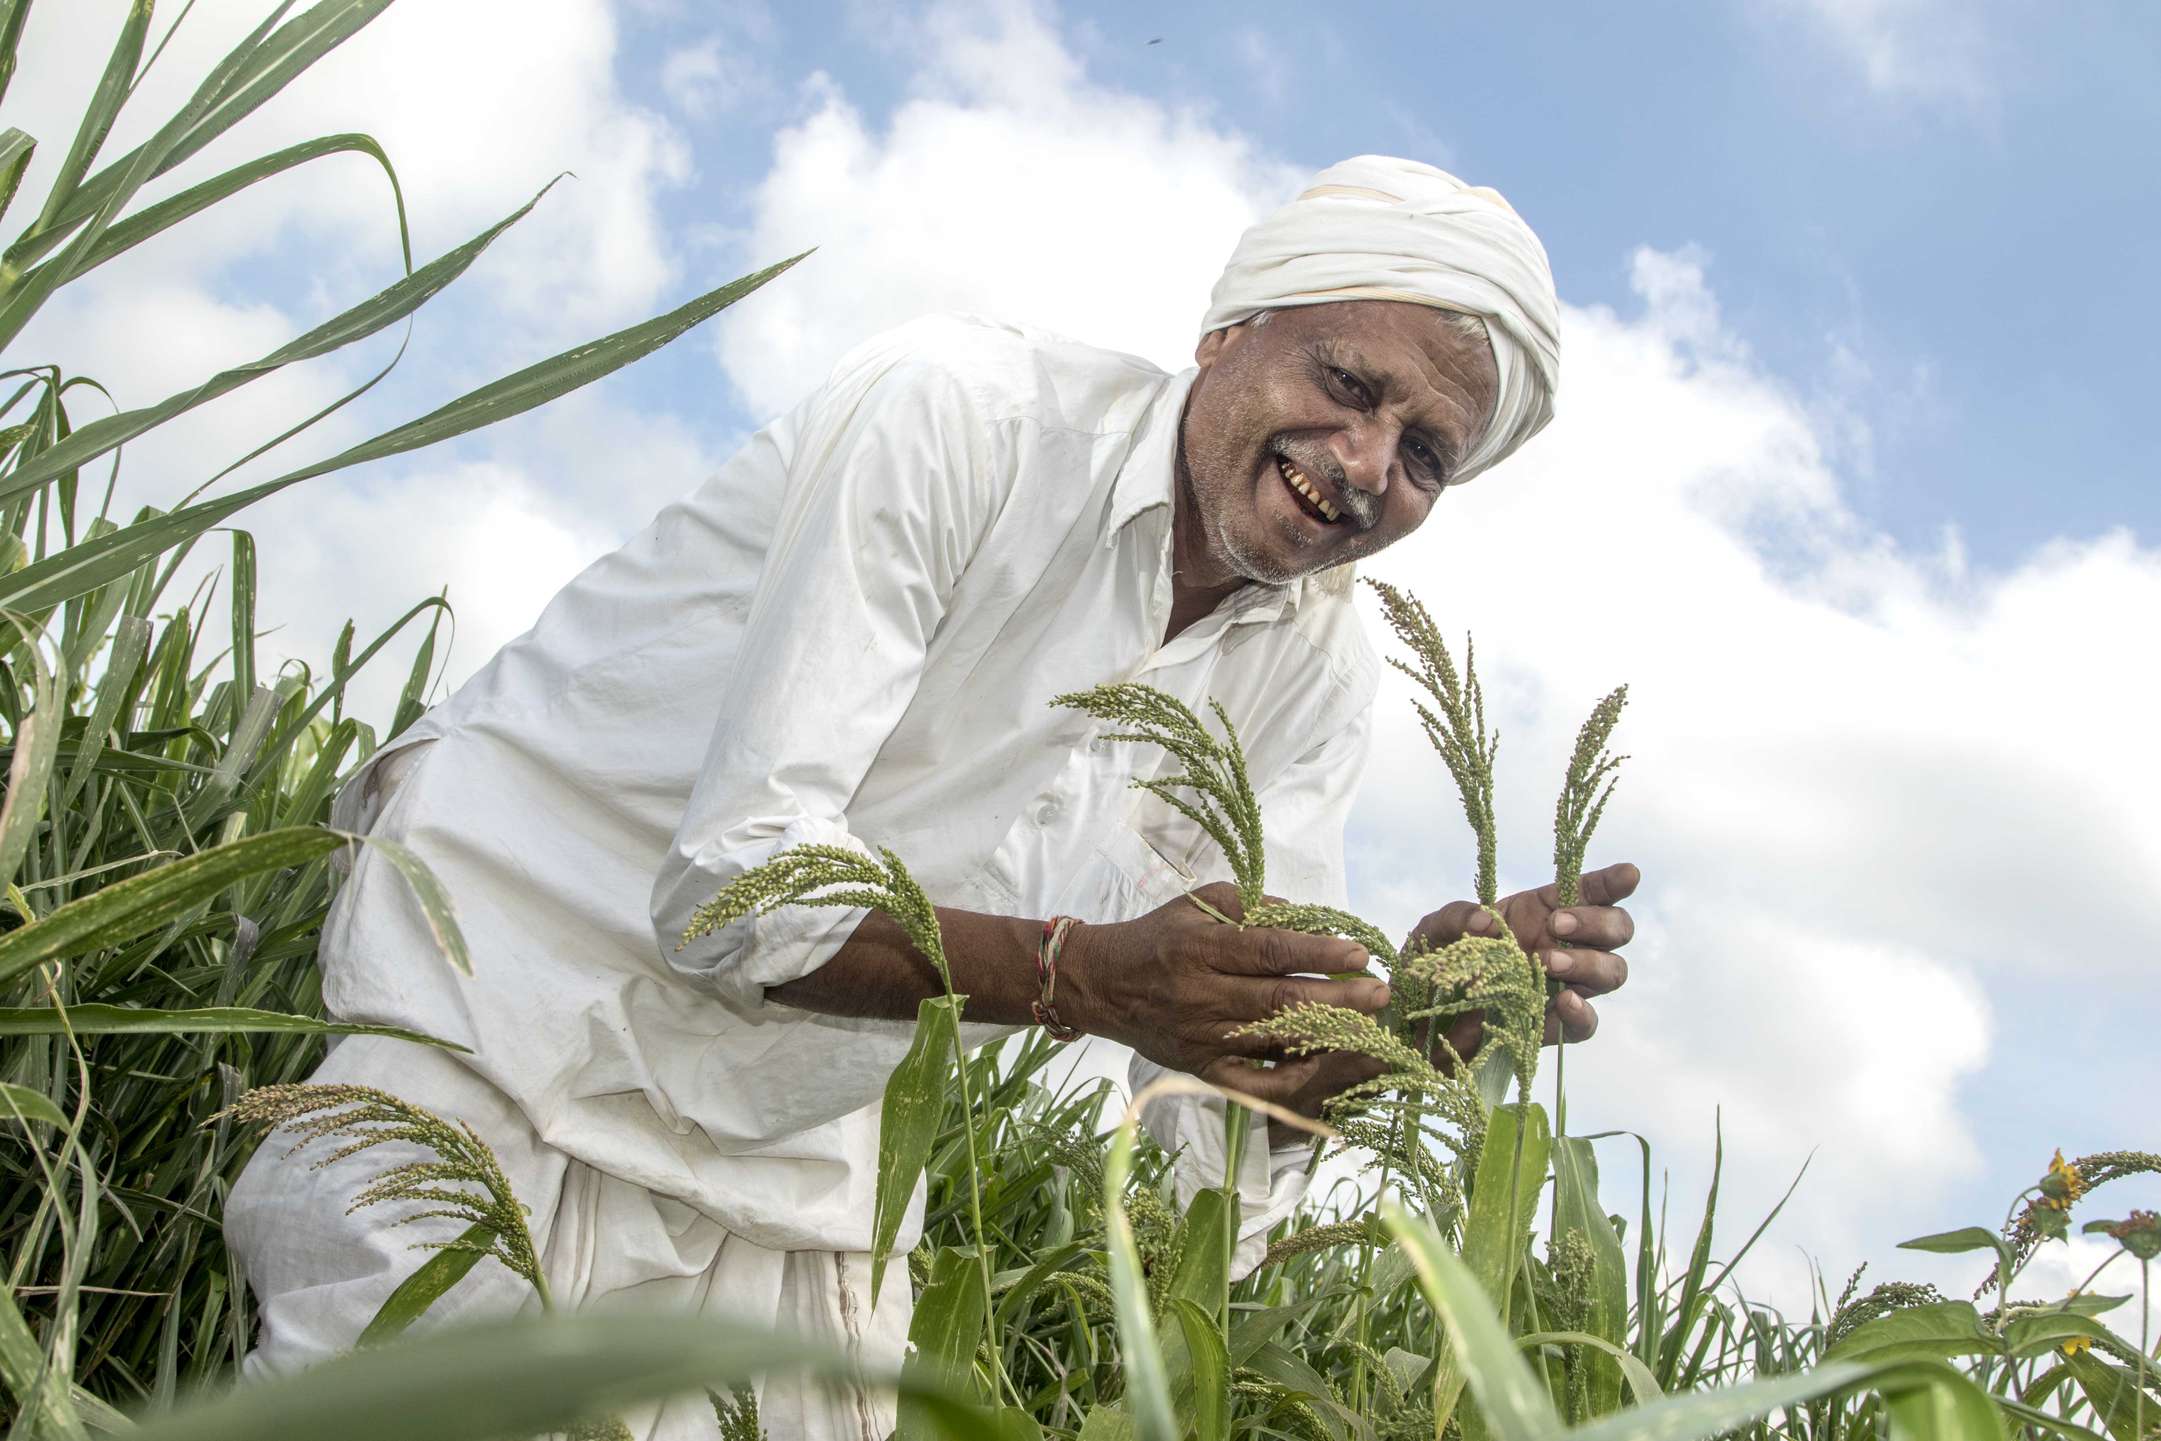

Slide 13
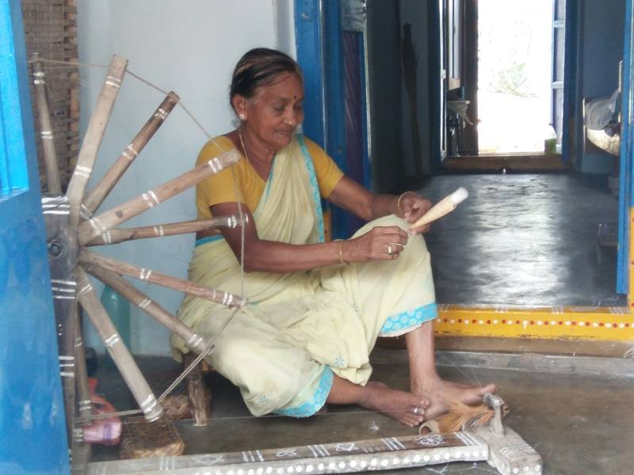

Slide 14
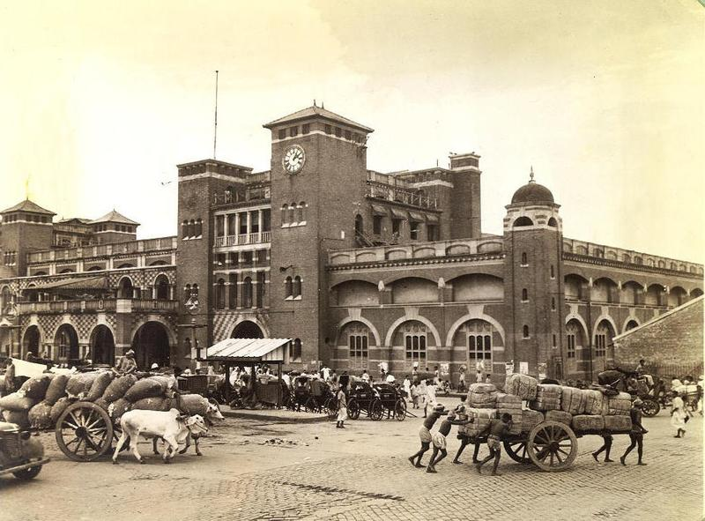

Slide 15
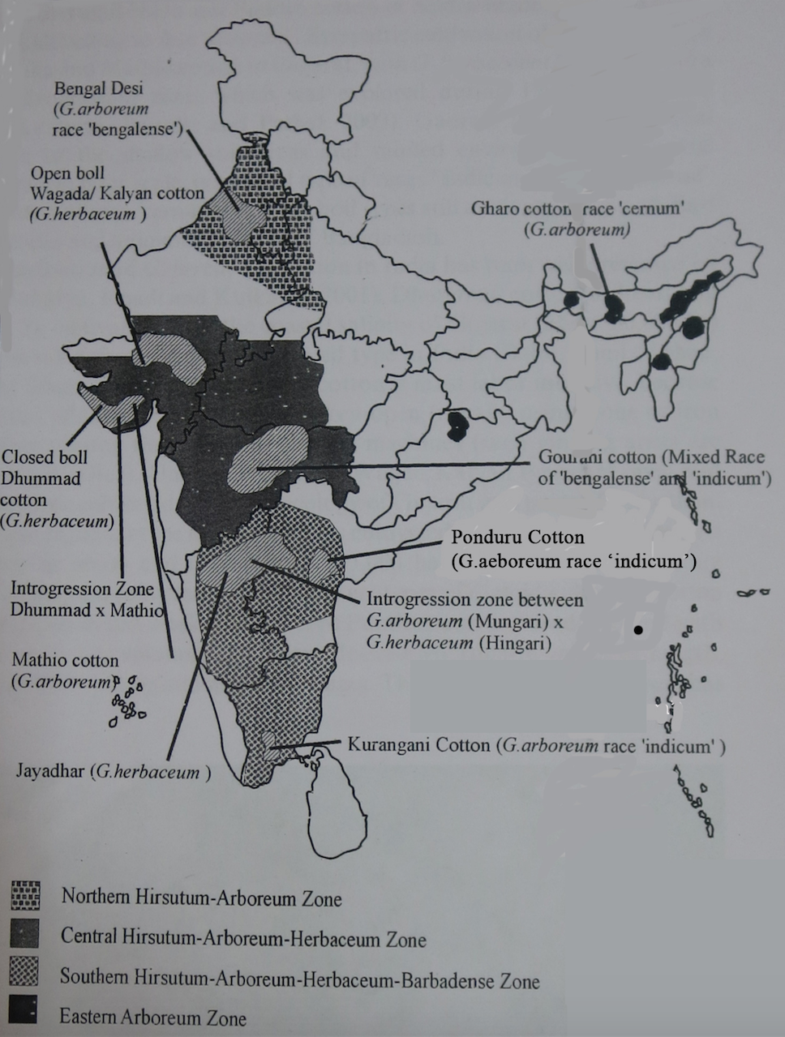
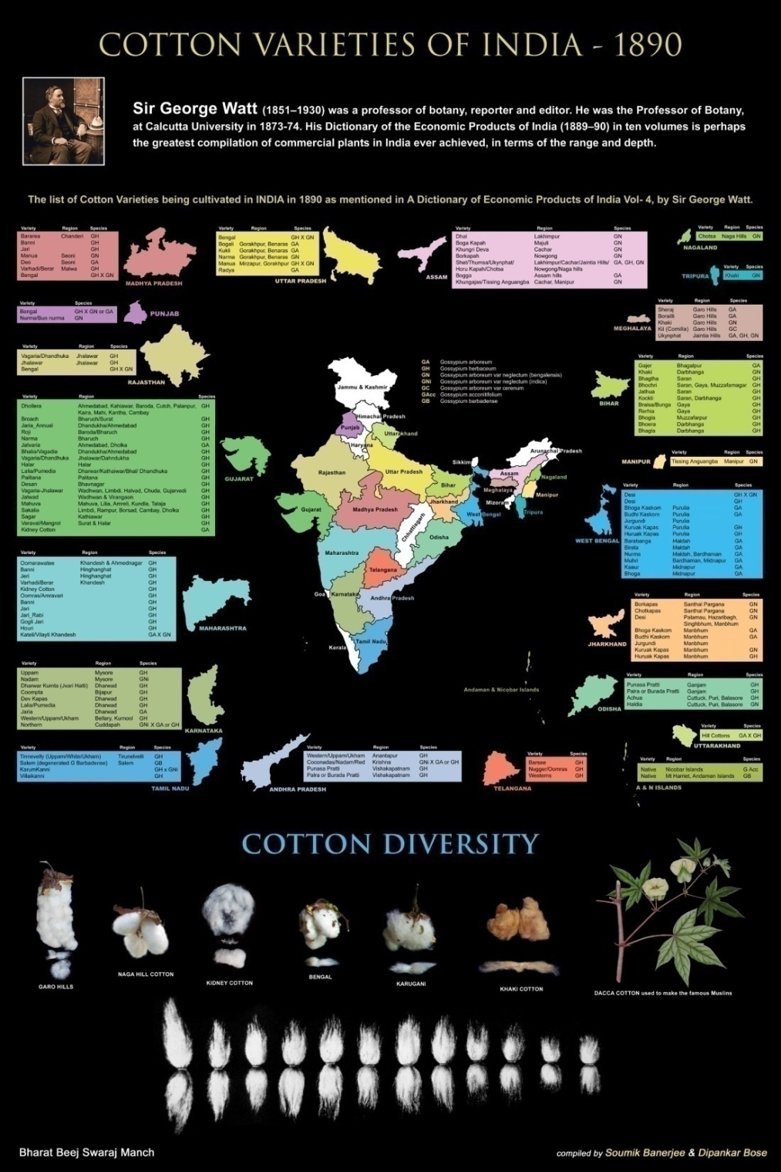

Slide 16
DESI COTTON GROWING AREAS
 | Variety | Geographical Area
1 | Jaydhar | Gadag,Dharwad
2 | Pandarapura | Hadagali, Koppal
3 | Karungani Paruthi | Southern Tinnevelly, Tamil Nadu
4 | Ponduru Cotton | Srikakulam Dist,AP
5 | Kala Cotton | Kuch,Gujrath
6 | Assam Cotton | West Garo Hills,Meghalaya
7 | Bengal Desi | West Bengal and Bangladesh
8 | Wagad Cotton | Gujrath and Rajasthan Border
9 | Erra Patti | Andhra Pradesh

Slide 17
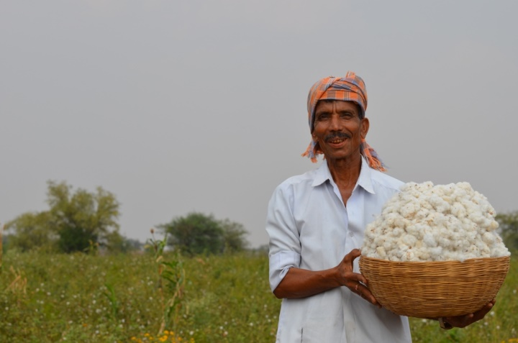
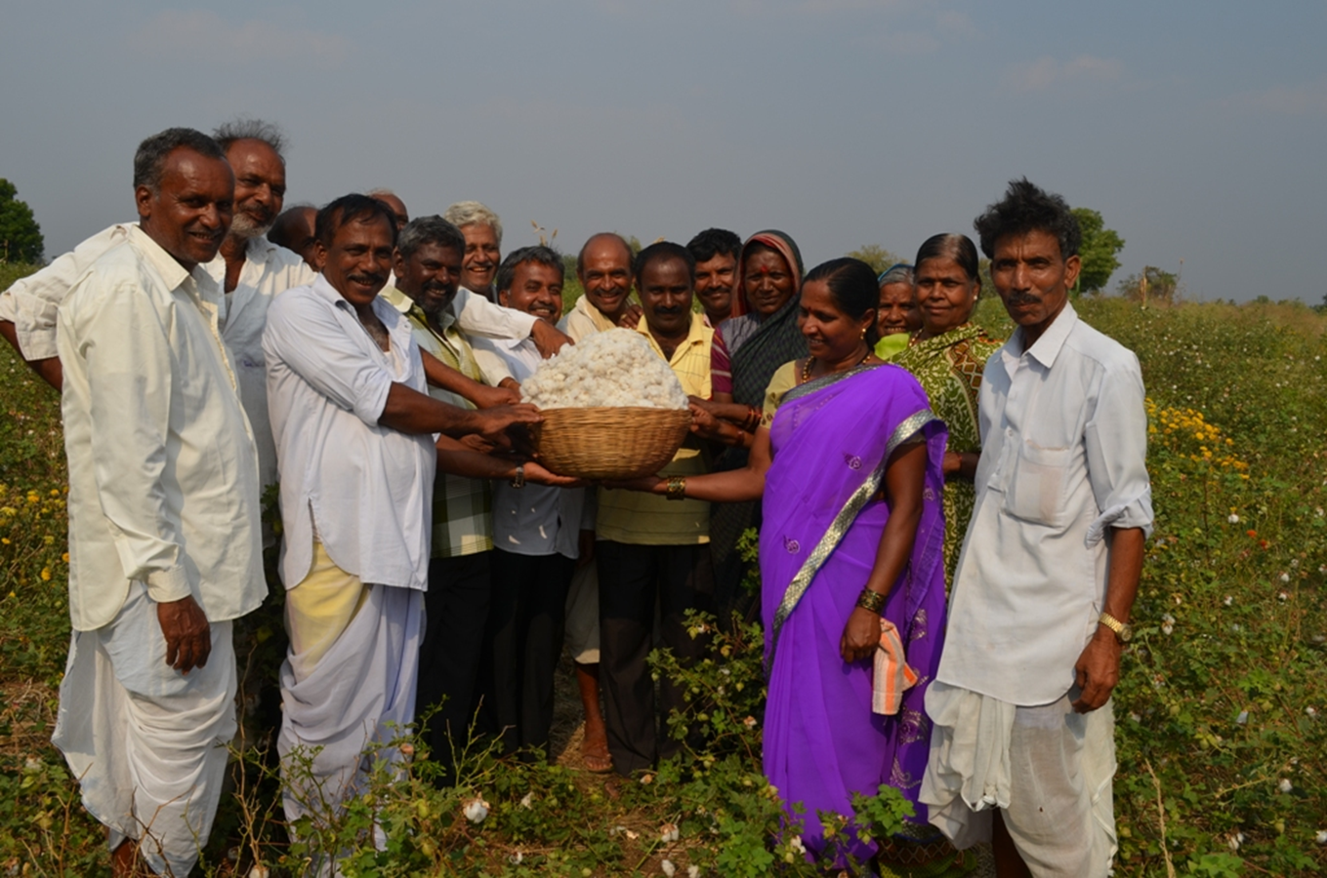
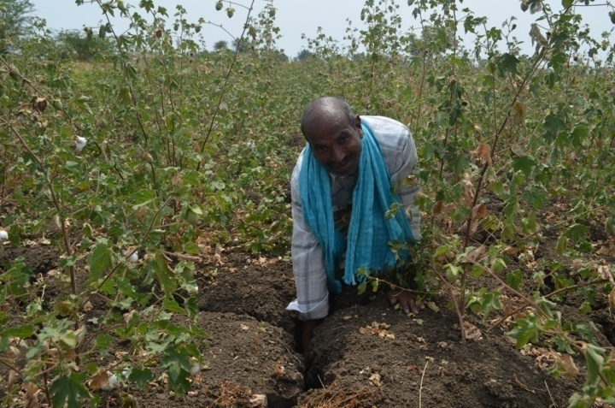
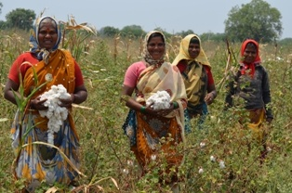

Slide 18
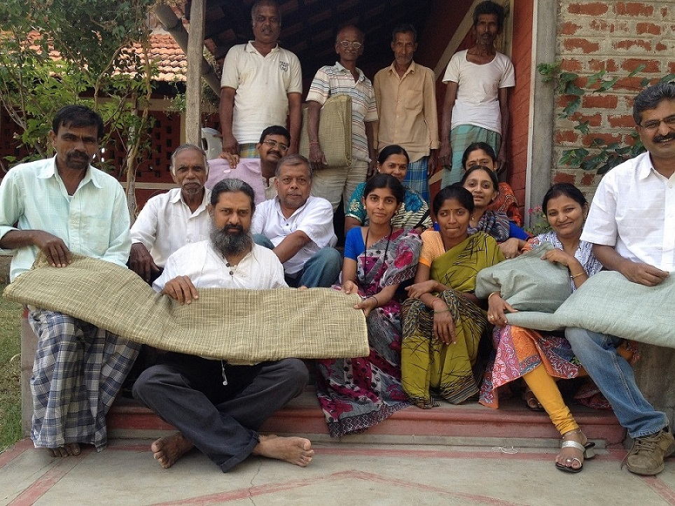

Slide 19
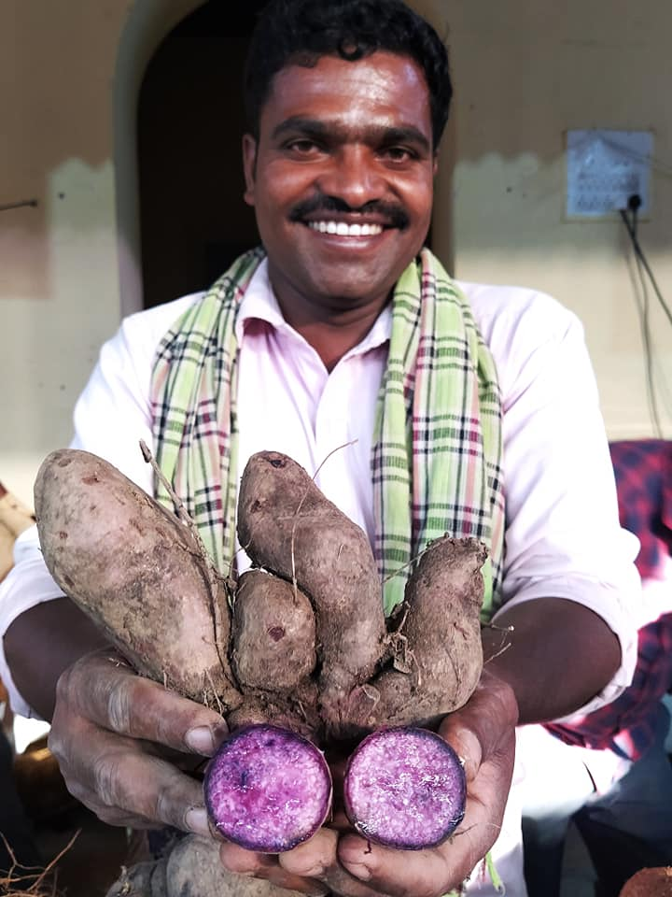
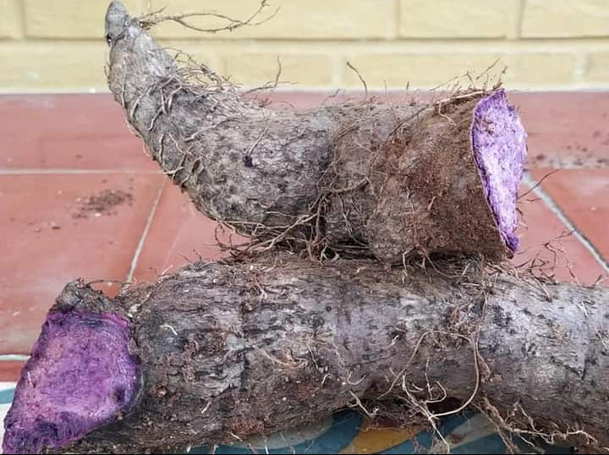
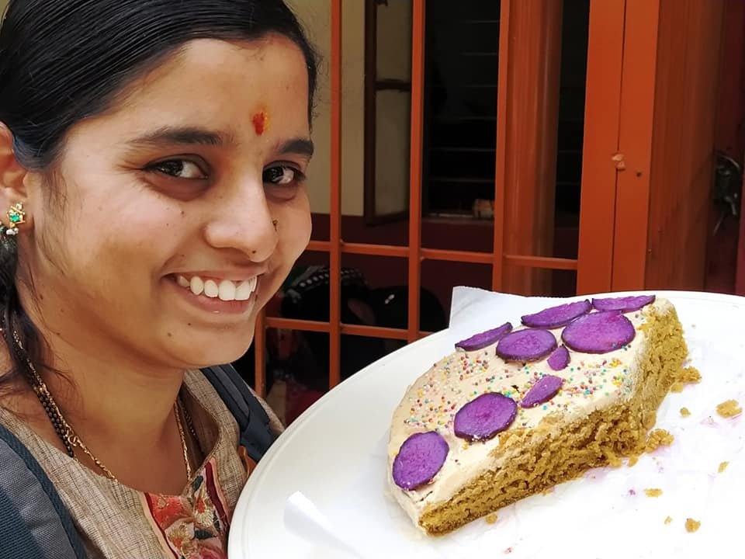

Slide 20
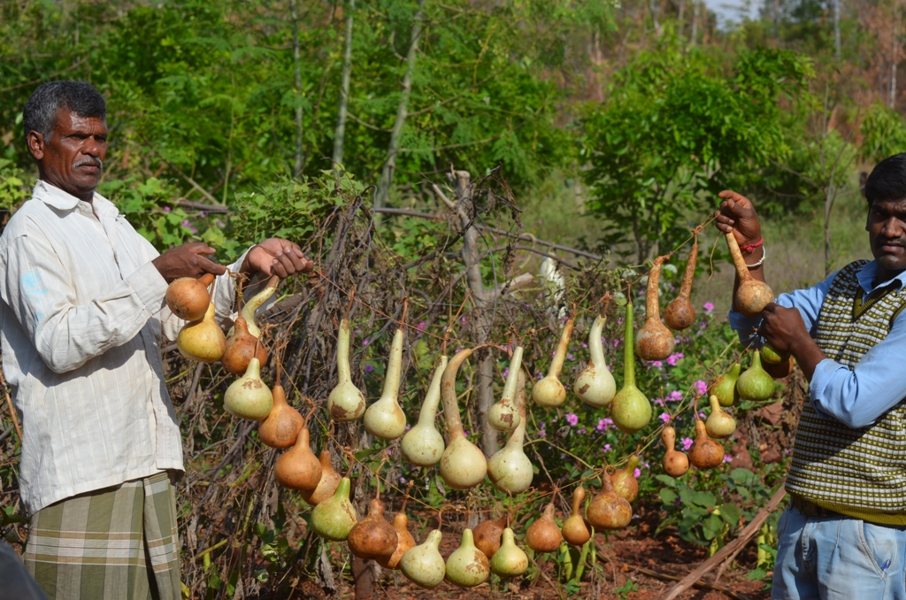
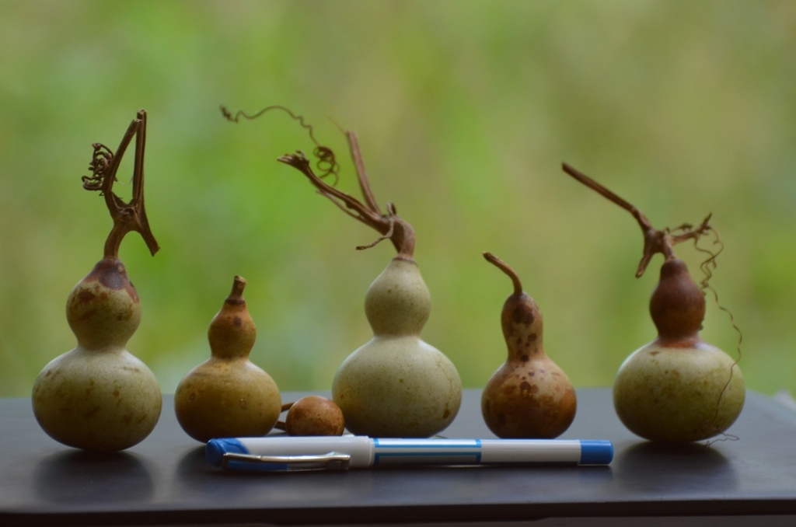
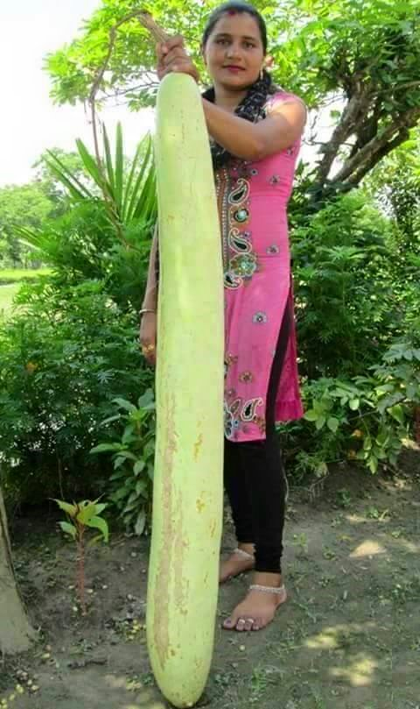
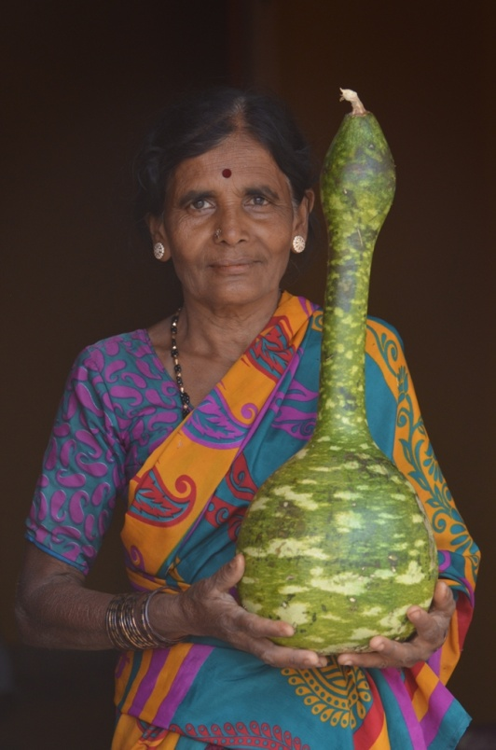
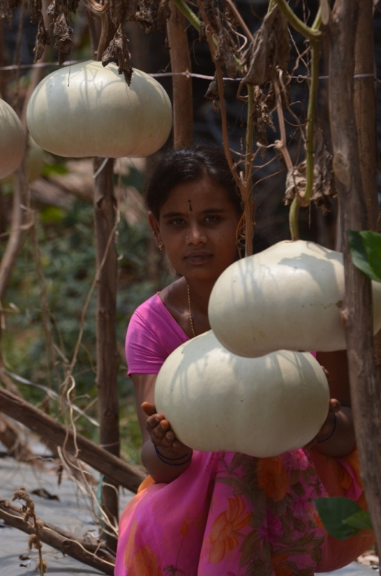
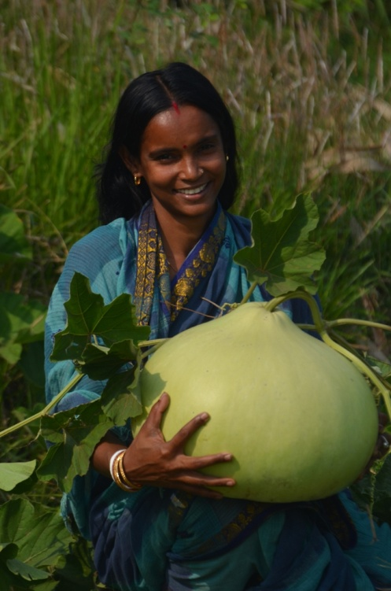

Slide 21
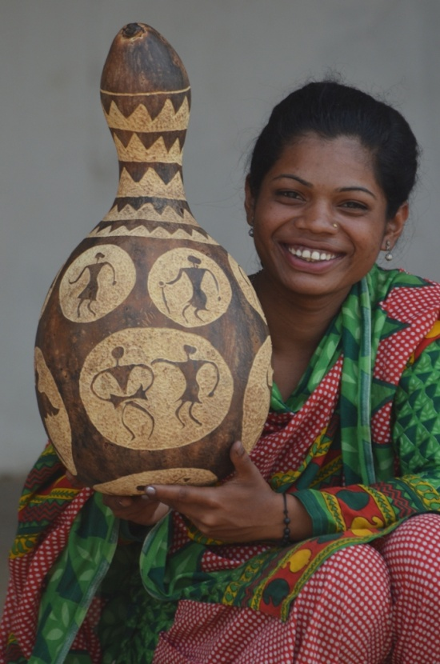
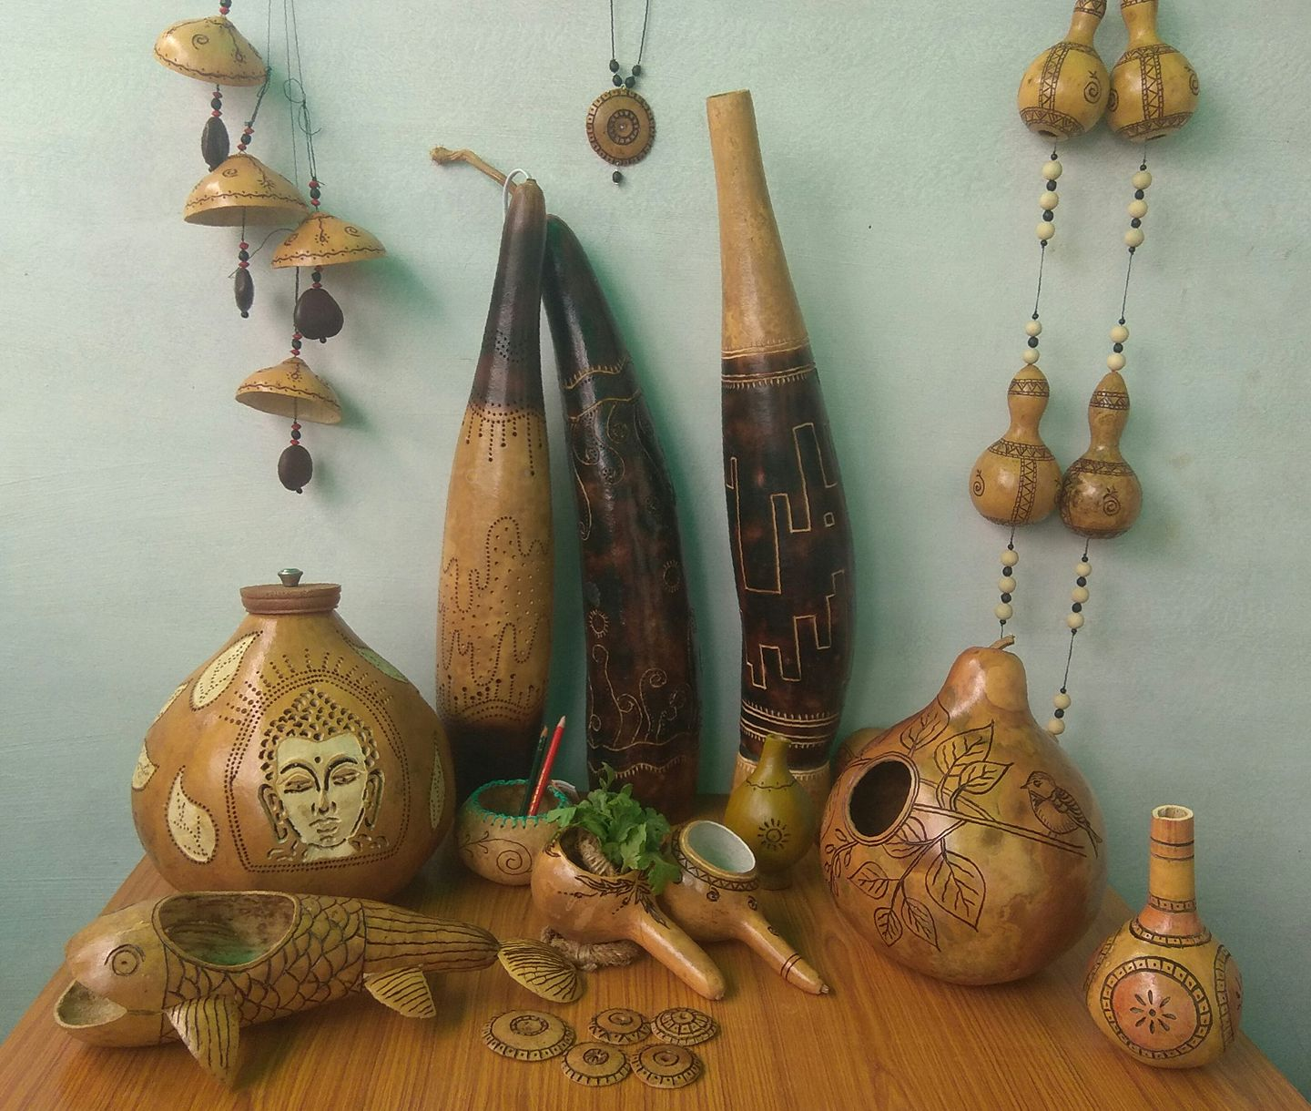
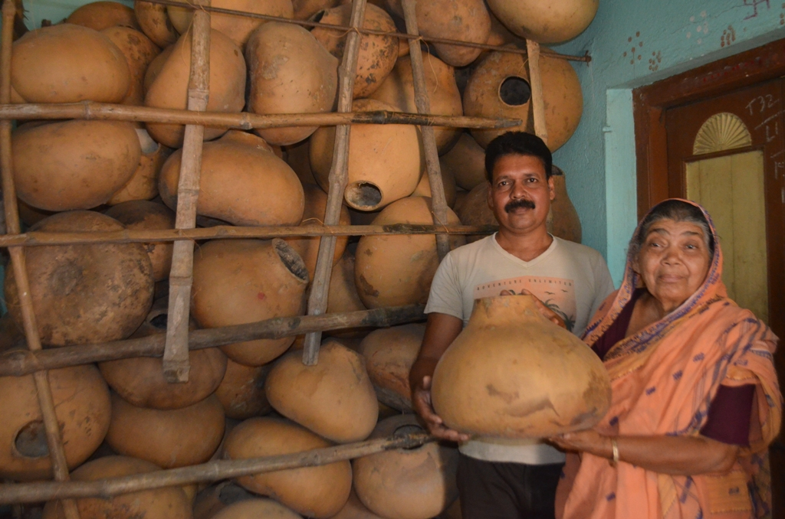
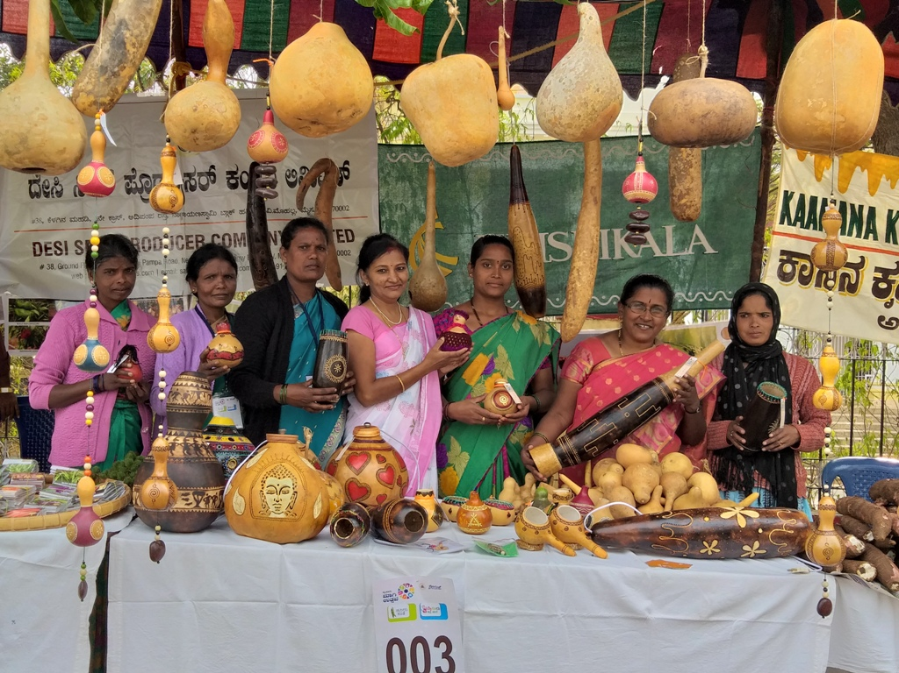

Slide 22
Linking Small Producers to the Markets

Slide 23
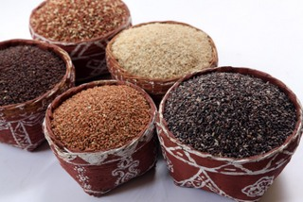
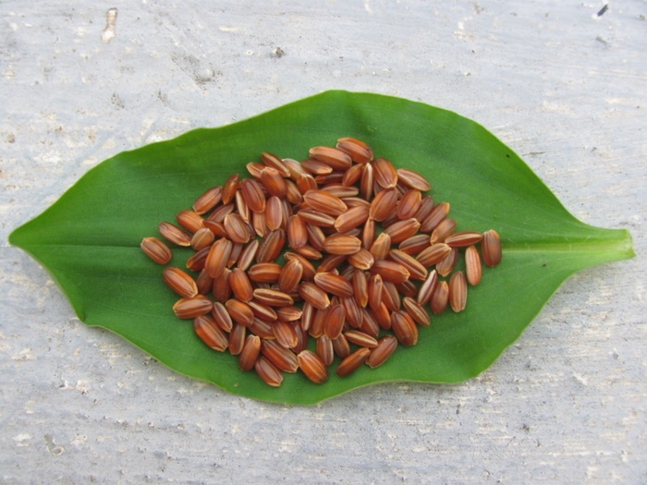
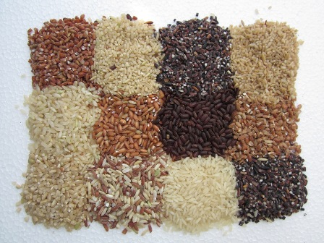
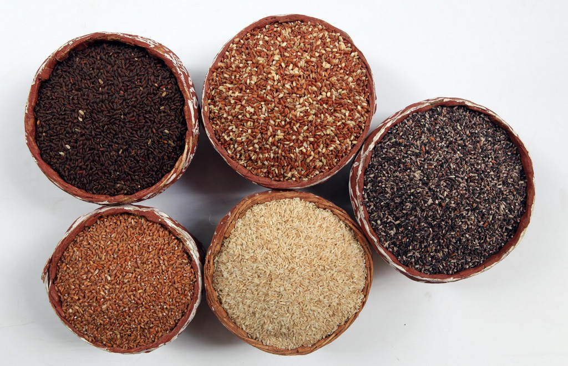

Slide 24
Lab analysis
Sl no | Variety name | Protein % | Fat % | Carbohydrates % | Crude fibre% | Calcium% | Phosphorous % | Iron (mg) | Energy/kcal/100g
1 | Ambe mohar | 6.47 | 1.00 | 78.84 | 0.97 | 0.29 | 0.31 | 0.8 | 350.24
2 | Doddabayra nellu | 7.04 | 2.18 | 76.28 | 1.07 | 0.20 | 0.23 | 0.8 | 352.9
3 | Navara | 8.12 | 2.14 | 78.18 | 1.05 | 0.42 | 0.48 | 1.2 | 364.46
4 | Kagisali | 6.67 | 1.89 | 80.84 | 0.66 | 0.26 | 0.24 | 0.6 | 367.05
5 | Karikalave | 5.30 | 0.29 | 81.76 | 0.76 | 0.30 | 0.39 | 0.7 | 350.85
6 | Ankura sona (Polished Hybrid variety) | 5.86 | 0.15 | 84.59 | 0.16 | 0.10 | 0.09 | 0.2 | 363.15

Slide 25
Don’t call it as Rice
Call them as …
Medicinal Rice: Navara, Mapille Samba
Pregnant Woman Rice -Kari Kalave
Joint Pain Rice – Navara
Rice to cure Herpis – Kari batha
Rice for Bridegroom -Mapille Samba
Indian Viagra – Navara
Rice for Diabetic – Pedda baira vadlu, Kari Jaddu

Slide 26
MILLET MELA
Linking farmers and consumers

Slide 27
ROOTS AND TUBERS

Slide 29
Publications

Slide 31
Forgotten foods calendar

Slide 36
Farmer bred varieties

Slide 38
‘DESI SEED PRODUCER COMPANY LTD’, India's first organic farmers seed company was established in 2014,to link organic seed producers to the market and promote farmer based seed supply systems while popularising the traditional seeds.

Slide 39
Thank You

